Slide 1

Chapter 6
Evaluating Quantitative Data
Matthew Valentine
Office: Tech Room Lab K2
mvalentine@uwc.ac.za

Slide 2

Learning objectives
To be able to calculate basic descriptive statistics using PROC MEANS.
To be able to calculate basic and advanced descriptive statistics, analyse characteristics of a set of data and be able to create histograms using PROC UNIVARIATE.

Slide 3
PROC MEANS
What is PROC MEANS useful for ?
It evaluates quantitative data in your dataset.
It defines means by groups.
It makes it easier to spot outliers within the data.
It produces a simple statistical summary report of the data.

Slide 4
PROC MEANS
The syntax of the PROC MEANS Statement is:
PROC MEANS <Options> <Statistical keywords>;
<Statements>;
The most commonly used <Options> in PROC MEANS are:
DATA
MAXDEC
The most commonly used <statistical keywords> in PROC MEANS:
Default keywords are:
MEAN, STD, MIN and MAX.
Additional <statistical keywords> FOR PROC MEANS:
NMISS
CLM
Example: In the editor window, open the file AMEANS.1.SAS

Slide 5
PROC MEANS
PROC MEANS DATA = SAS DATASET <Options>;
VAR variable(s);
BY Variable(s) Variable(s);
CLASS Variables(s) Variables(s);
RUN;
The commonly used statements for PROC MEANS:
VAR – Identifies which variables to analyse (One or more)
BY – Identifies a number of categories to be analysed by a specific variable
CLASS – Specifies variables that the procedure uses to group the data in classification levels.
Example: In the editor window, open the file AMEANS.2.SAS

Slide 6
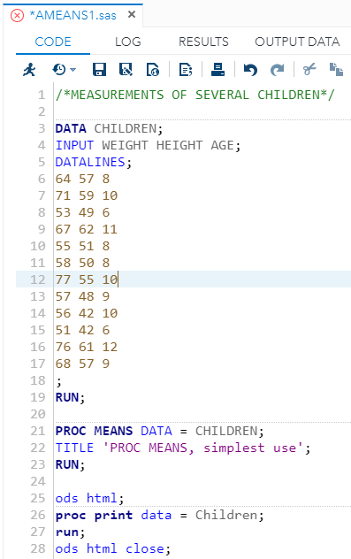
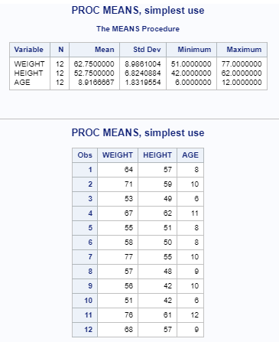
Proc Means
Describes numerical/quantitative data.
Creates a tabular and/or graphical summary of the data.
Can provide a summary for each unique group (using either the BY or CLASS statements).
By default this procedure will calculate n, mean, std, min and max values.

Slide 7
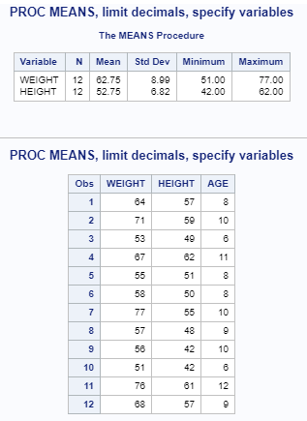
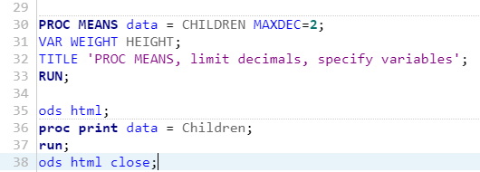
Proc Means

Slide 8
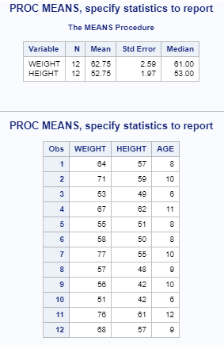
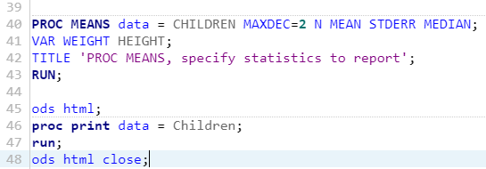
Proc Means

Slide 9
Proc Means Statement options
MAXDEC = n – specify decimal places
N – number of observations
NMISS – number of missing observations
MEAN – arithmetic average
STD – standard deviation
MIN - minimum value
MAX – maximum value
RANGE – range of observations
SUM – sum of the observations
VAR - variance
STDERR – standard error
MEDIAN – middle value or 50th percentile

Slide 10
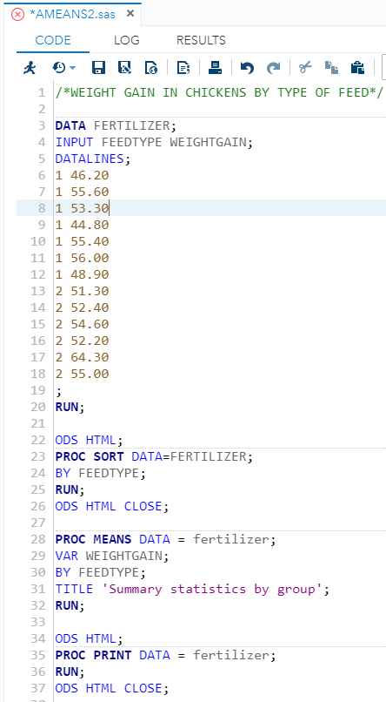
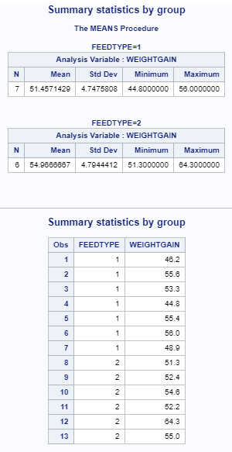
Proc Means BY - Statement
Example: In the editor window, open the file AMEANS.2.SAS

Slide 11
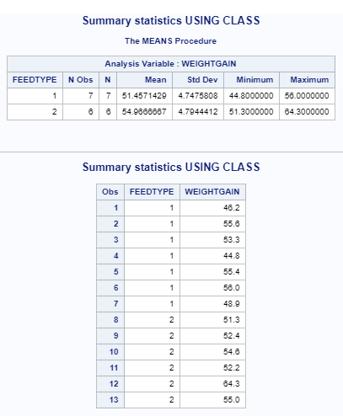
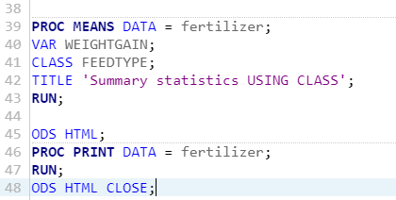
Proc Means CLASS - Statement
Example: In the editor window, open the file AMEANS.2.SAS

Slide 12
Proc Univariate
What is PROC UNIVARIATE useful for?
To observe whether the data are approximately normally distributed. In the form of a Histogram.
To spot if there are outliers present within the data.
To observe whether data distributions for variables differ by group.

Slide 13
Proc Univariate
The syntax for the PROC UNIVARIATE is:
PROC UNIVARIATE <Options>;
Statements>;
The most commonly used <Options> for the PROC UNIVARIATE are:
DATA – Specified Dataset
NORMAL – Provides the Test for Normality Table
PLOT – Provides distribution and Probability plots
Additional <Options> in PROC UNIVARIATE are:
TRIMMED – Trims the top and bottom of the data before calculating the mean.

Slide 14
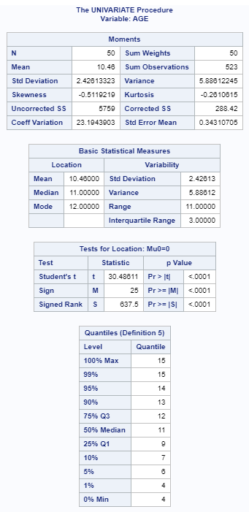
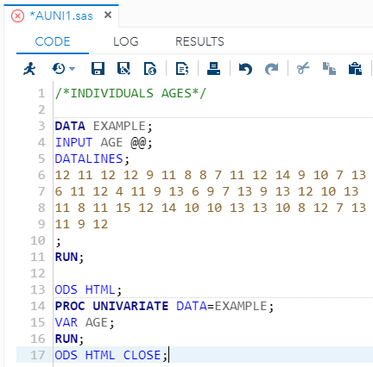
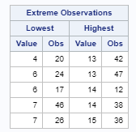
Proc Univariate
Used to test if the data is normally distributed, helps identify outliers and produces graphs and plots.
Example: In the editor window, open the file AUNI1.SAS

Slide 15
Proc Univariate
PROC UNIVARIATE DATA = SAS DATASET <Options>;
VAR variable(s);
HISTOGRAM variable(s) </Options>;
QQPLOT variable;
PROBPLOT variable(s) </Options>;
INSET keywords </Options>
RUN;
The commonly used statements for PROC UNIVARIATE:
VAR – Identifies which variables to analyse (One or more).
HISTOGRAM – is a graphical display of the distribution of a set of data.
INSET – displays descriptive statistics in the graph. (4.0) – Is a type of format see Table 2.4.
QQPLOT – is used to produce a higher quality normal probability plot.
Example: In the editor window, open the file AUNI4.SAS

Slide 16
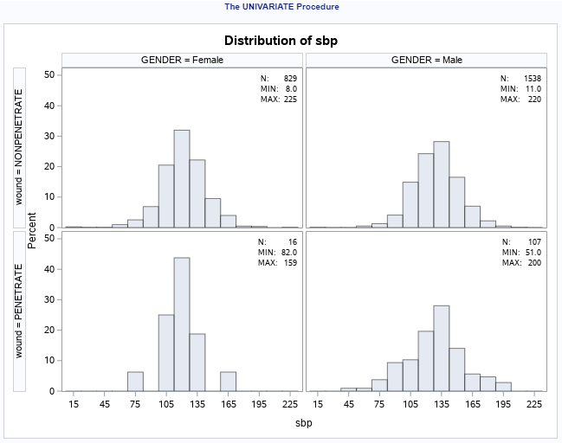
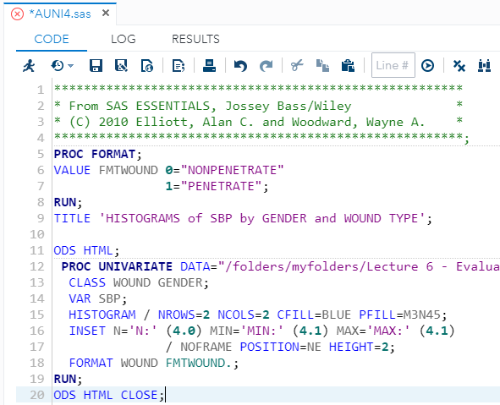
Proc Univariate
Example: In the editor window, open the file AUNI4.SAS

Slide 17
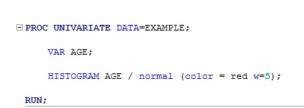
Proc Univariate Histogram Statement options
NORMAL – superimposes a bell-shaped/normal curve over the histogram
COLOR – specifies the color of the curve
W = … - specifies the width of the curve

Slide 18
Proc Univariate Statement options
CIBASIC – confidence intervals for the mean, std and var
ALPHA = … - specifies the alpha for the intervals
MU0 = … - specify the parameter for a t-test of the mean
NORMAL - provides test statistics for a normality test of the data
PLOTS – produces stem-and-leaf, box and normal probability plots

Slide 19
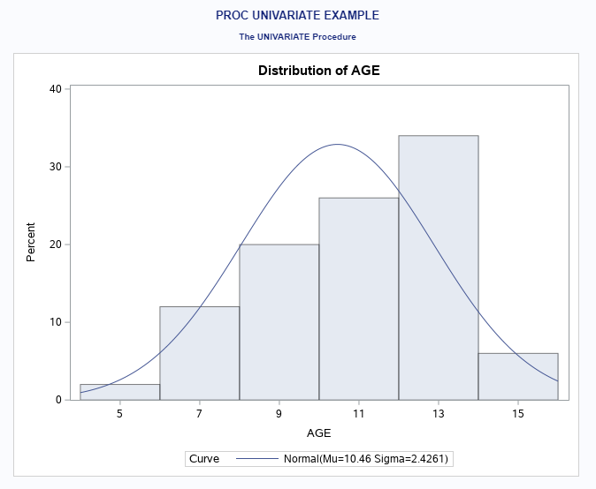
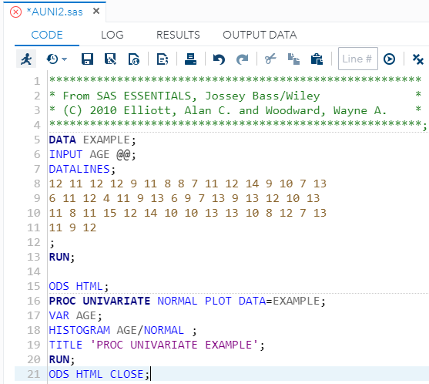
Proc Univariate
Example: In the editor window, open the file AUNI2.SAS

Slide 20
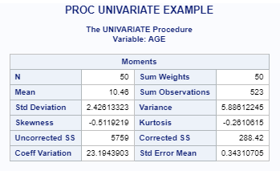
Proc Univariate output
Skewness – measure of symmetry (should be close to 0)
Kurtosis – measures the shape of the distribution (should be equal to zero), a positive value indicates more peaks in the data and vice versa for a negative value
Example: In the editor window, open the file AUNI2.SAS

Slide 21
Study
Chapter 6
Matthew Valentine
Office: Tech Room Lab K2
Mvalentine@uwc.ac.za

